Slide 1
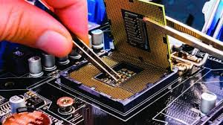

IMPACT OF ELECTRONIC DEVICES IN SOCIETY AND INDUSTRY
Name : kalyan chakravarthy
registration number: 21BAI1759
BRANCH: CSE WITH SPL AI&ML
SUBJECT:ELECTRONICS COMMUNICATION AND ENGINEERING
COURSE CODE: BECE101L
TOPIC:IMPACT OF ELECTRONIC DEVICES IN SOCIETY AND INDUSTRY

Slide 2
Now days the impact of electronics in industry and society is constantly increasing daily. The era of modern evolution is expanding day by day. Just like all other fields, the Electronics field is also growing. Electronics has taken a fundamental space in everyone’s life. Whether we talked about mobile phones, tablets, COMPUTERS, alarms, clothing machines, cooking machines, TV, Gaming Gadgets and a lot more.

Slide 3
Impact of Electronics in Communicating the Society Electronics assume a significant part in advanced camera invention likewise these days, gadgets like mobile and tablet have the digital camera, which facilitates us to catch pictures and do quick video recording, which can be transferred any social media platform like Facebook, WhatsApp and so on.

Slide 4
Impact of Electronics in Creating Career Opportunities The electronics bussiness is rising exceptionally quickly and is producing great career openings in ventures like cell phones, IT industry, TV, PCs, tablets. What's more, there are great choices regarding professional purchaser durables, oil and gas, biochemical and power devices. Moreover, it has various applications fluctuating from social insurance, healthcare, satellite interaction, mobile or portable interaction (2G, 3G, 4G ), media transmission and Internet innovation.

Slide 5
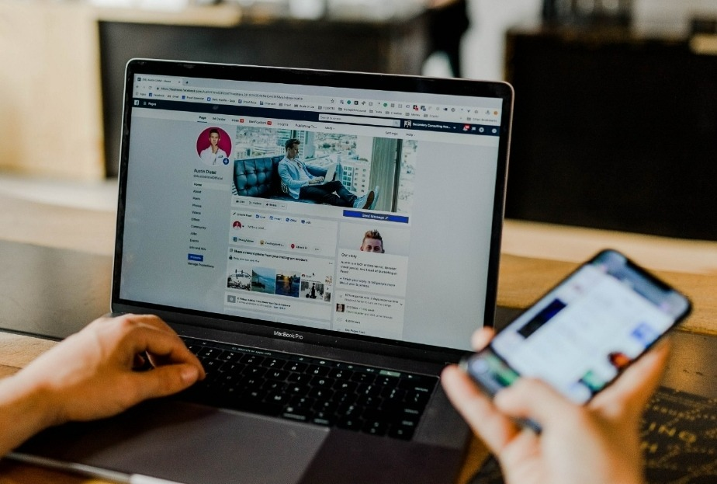
IMPACT OF COMPUTERS IN SOCIETY AND INDUSTRY
COMPUTERS HAVE CHANGED THE WAY PEOPLE RELATE TO ONE ANOTHER AND THEIR LIVING ENVIRONMENT, AS WELL AS HOW HUMANS ORGANIZE THEIR WORK, THEIR COMMUNITIES, AND THEIR TIME. SOCIETY, IN TURN, HAS INFLUENCED THE DEVELOPMENT OF COMPUTERS THROUGH THE NEEDS PEOPLE HAVE FOR PROCESSING INFORMATION.

Slide 6
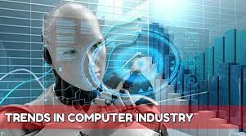
impact of Computers on Work: One of the ways that computers have made an impact on society is in how people have organized themselves in workplace groups in relationship to computers. The earliest computers were developed to perform specific tasks in science, engineering, or warfare that had previously been done by hand.

Slide 7
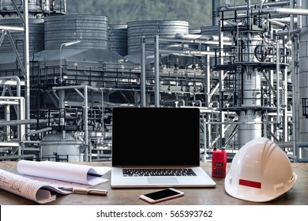
Positive Impact of Computer: It facilitates business process and other activities. It makes the work simple and less time consuming. We can store so many information on computer which makes easy to handle the information for business applications.We can perform multitasking and multiprocessing capabilities of data. Computers changed the world a lot.It helped man step forward into the future.Thanks to COMPUTERS space exploration came true, new designs of vehicles and other transportation were made; entertainment became more entertaining, medical science made more cures for diseases, etc.

Slide 8
Computer can bring people closer together and facilitate contacts between them using Email, Chatting, Videoconferencing, Mobile Phones and Social Medias. It saves time, efforts and money compared with letters used, before making influence of computers in human life. NEGATIVE IMPACTS OF COMPUTER: CHANCES OF DATA STOLEN AND HACKING THAT DESTROYS DATA.IT IS FAST CHANGING TECHNOLOGY SO IT IS REQUIRED TO BE UPDATED TIMELY.

Slide 9

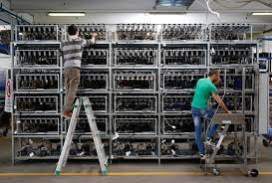
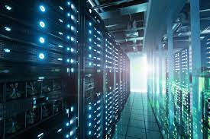
Computers have become the part of every organization but at the same time there are also some negative impacts of computer on society which are needs to be overcome.

Slide 10
Thank you

